Slide 1
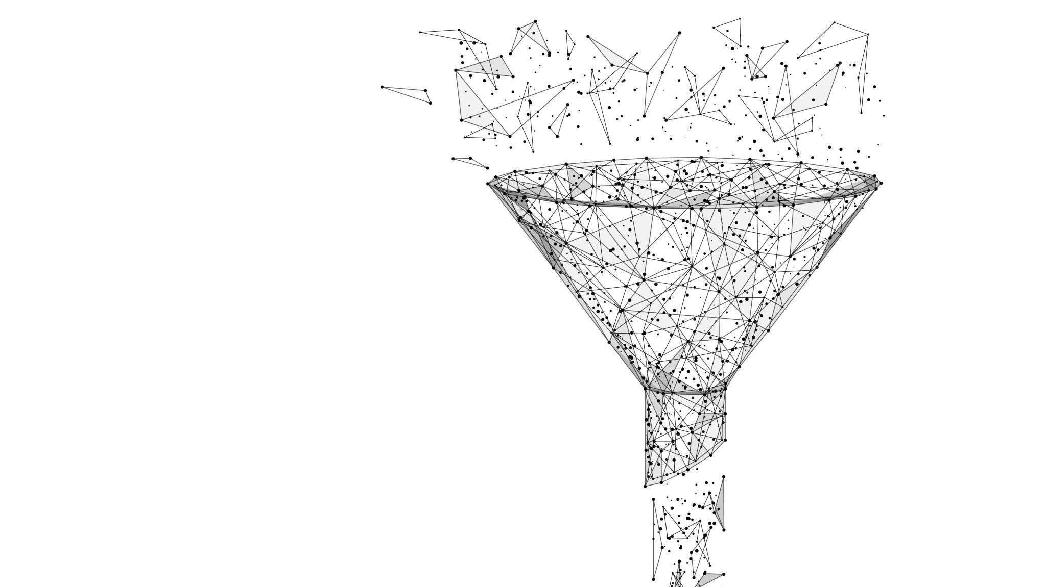
Position Beacon Network Design
By Marcos Ramirez
New Mexico State Undergraduate
Mechanical and Aerospace Engineering
11/14/2025

Slide 2
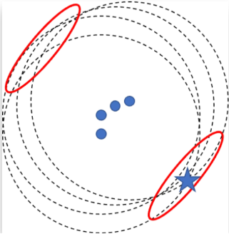
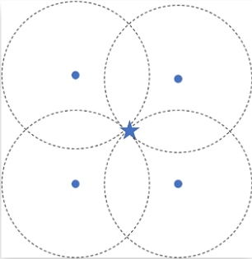
Beacon Positioning and Amount
Required a minimum of 3 to 4 beacons for accuracy
Should be spaced apart to prevent Non-Line of Sight(NLOS)
Best position is to set in grid like position
If grid position not possible use beacon diversity (tags placed in multiple coordinates)
Average space for beacon is 7-10m (can change depending on type)

Slide 3
DOP Values
DOP is term used to specify the number of errors in positional fix
Range should be less than 20 ideally as close to 1> as possible
Calculated through a combination of Position, Horizontal, Vertical, and Time DOP
PDOP - number of satellites spread over, more above and less on horizontal the lower this value
HDOP – the more visible satellites lower in the sky the better the latitude and longitude position are
VDOP- the more visible lower satellite in the sky is the better the value for altitude
TDOP- different in time for internal receiver and satellites clock

Slide 4

Redundancy Strategies
Power failure
Changing single power feed todual power feeds
Ensures constant power if 1fails
Secondary power supply
Must be an uninterruptiblepower supply (UPS)
Must ensure seamless powerdistribution
Automatic transfer switch (ATS)
Enables to switch back and forthfrom power supplies
Multiple circuit paths ​
Prevents single cable failure​
Disaster recover (DR)​
Final failsafe if main powersource is lost​
Ensures sites remain online​
AI driven power monitor​
Prevents unexpected failuresand point for circuit breaks,UPS and generators to fail​
Able to distribute poweraccordingly

Slide 5

Power Source
Solar Panels
Upsides
  Least expensive
  Easy Installment
Drawbacks
  Dust layers
  Dust particles stayover time
  Night loss of energy
Nuclear Fission
Upsides
  Unaffected by day and night
  Portable in volume constrained environments
Drawback
  Expensive
  If fails hard to repair

Slide 6
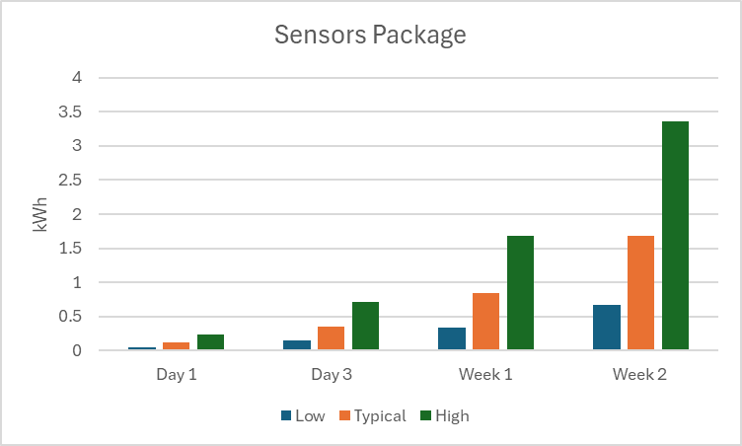
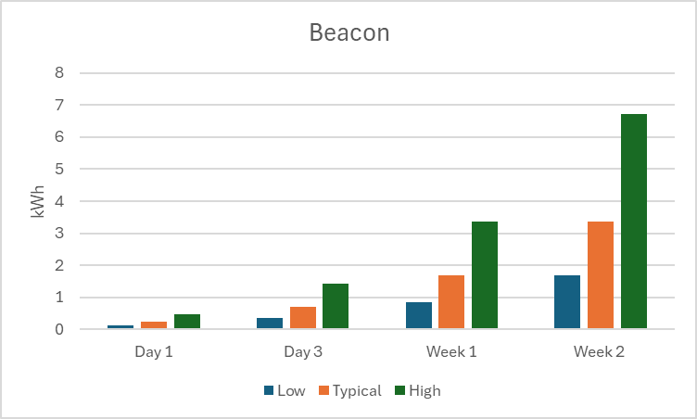
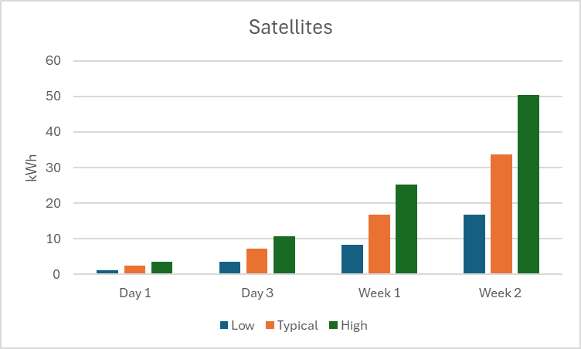
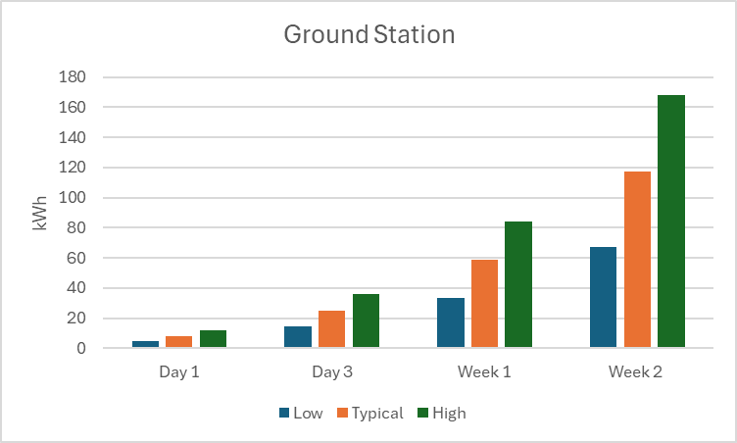
Energy Consumption Estimates

Slide 7

Multi-use Beacon ideas
Proximity- Based Services (PBS)
Alerts for nearby beacons, restricted zones, equipment and guidance
Location-Based services (LBS)
Positioning for complex modules
Real- Time locating Systems (RTLS)
Ensures accurate navigation and resource management when GPS is unavailable of unreliable
Integrated Sensors
Used for monitoring, and triggering functions

Slide 8

Key Takeaways & Q/A
Beacon Networks
Must be balanced in quantity, spacing, and geometry for accuracy
DOP Values
Critical indicators of positional reliability
Power resilience
Redundancy + sustainable resources
Beacon Use
Positioning, safety,monitoring, andcommunication
Redundancy
Prevents mutltiple failurepoints

Slide 9


Food

